Slide 1


Detection of Impersonation In Online Examinations
Anjana M S
MES20MCA-2009
Product owner :Balachandran K P

Slide 2


TABLE OF CONTENTS
Introduction
Modules
Data Flow Diagram
Table Design
Developing Environment
Product Backlog
User Stories
Project Plan
Sprint Plans
Sprint Actual

Slide 3
Detection of Impersonation In Online Examinations Using Blockchain
We are living in the era where office work is becoming work from home and examinations are becoming online examinations. In online examinations there is a lot of chance of impersonation. This paper proposes a method to overcome the downside of online examinations which is impersonation.
This approach aims in increasing the credibility of online exams and eliminate the need for an examiner so that the exams can be taken from any convenient location. In recent days, the candidate appearing for an online examination is authenticated by carrying out manual verification of the candidate’s credentials by the examiner. Conducting an automated face authentication at the beginning of the examination will check the identity of the user.
For this type of authentication, we use facial recognition system which uses the Viola-Jones algorithm, and SVM (SUPPORT VECTOR MACHINE) for detection and recognition respectively.

Slide 4
Face Authentication
We use image processing toolbox to perform the face authentication. Just like any other form of biometric identification, face recognition requires samples to be collected, identified, extracted with necessary (features) information, and stored for recognition. The algorithm that is used for face recognition is Viola-Jones algorithm and SVM (Support Vector Machine).
Dlib and openCV packages in python is used for the face recognition algorithm and for image processing. After identifying the face next step is feature extraction. HOG features are extracted from the image and then start comparing with the image in the database to identify whether he/she is a valid user or not. If it matches up to 60% to70% he/she is a registered user. If it is not satisfying the threshold value he/she is an invalid user.
B. Online Examination Portal
After face authentication, the candidate is provided with the examination on portal which is built using Python where they can download the question paper and write their exam ,after that they can upload the answer scripts

Slide 5
MODULES
ADMIN
Login
Student Registration
Add Subjects
Add Questions & Answers
Upload Study Materials
Exam scheduling

Slide 6
STUDENT
Login
View Subjects
View Study Materials
Attend Exam

Slide 7
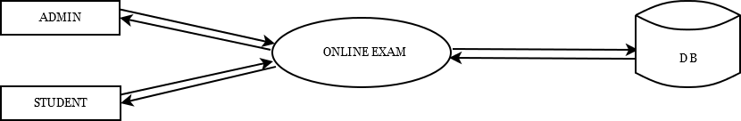
DATA FLOW DIAGRAM
LEVEL 0

Slide 8
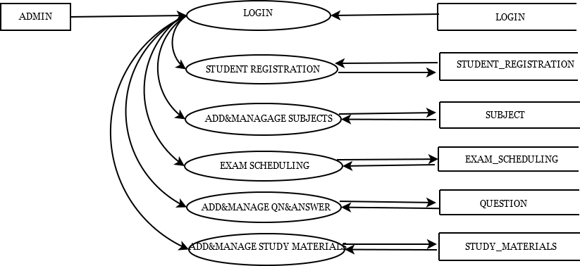
LEVEL 1.1

Slide 9
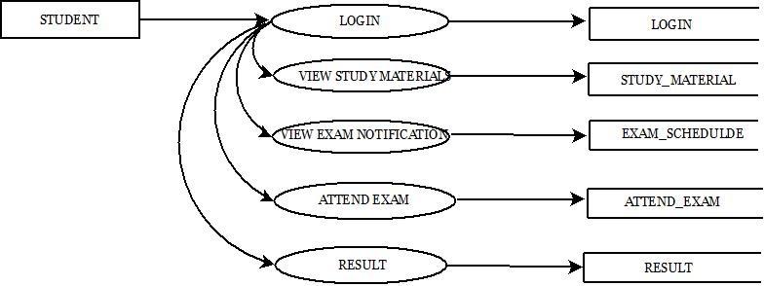
LEVEL 1.2

Slide 10
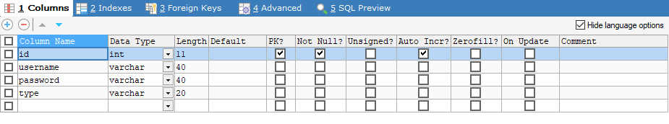
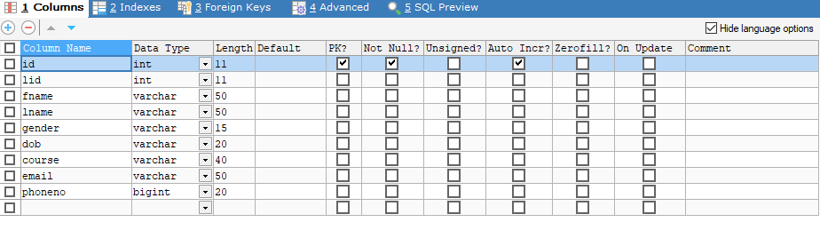
TABLE DESIGN
Login
Student Registration

Slide 11
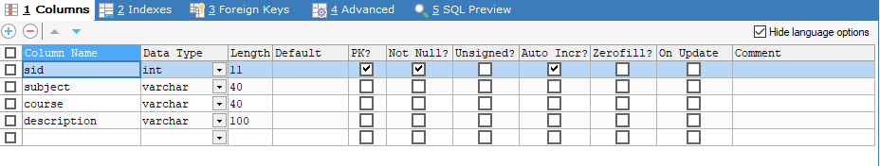
Subject

Slide 12
DEVELOPING ENVIRONMENT
OPERATING SYSTEM: WINDOWS 10 AND ABOVE
FRONT END: HTML, CSS, JAVASCRIPT
BACK END: Mysql
SOFTWARES USED: Jetbrains Pycharm, Android Studio ,SQLyog
TECHNOLOGY USED: PYTHON,JAVA
FRAME WORK USED:Flask

Slide 13
USER STORIES
User Story ID | As a type of User | I want to <perform some task> | So that I can < Achieve Some Goal>
1 | Admin | login | login successful with correct username and password
2 | Admin | student registration management | add student, manage student
3 | Admin | add and manage subject | mange subjects
4 | Admin | add questions and study materials | manage questions and materials
5 | Admin | schedule exam | Create examination portal
6 | User | login | login successfully with correct username and password
7 | User | view study materials | view study materials in application
8 | User | view examination notifications | view notifications
9 | User | attend exams | identity verification and face recognition

Slide 14
PRODUCT BACKLOG
User story ID | Priority <High/Medium/Low> | Size (Hours) | Sprint <#> | Status <Planned/In progress/Completed> | Release Date | Release Goal
1 | Medium | 2 | 1 | Completed | 8/01/2022 | Table Design
2 | High | 3
1 | High | 5 |  | Completed | 8/01/2022 | Form Design
3 | High | 5 |  | Completed | 8/01/2022 | Basic Coding
4 | High | 5 | 2 | Planned |  | Face Recognition
5 | Medium | 5 |  | Planned |  | SVM algorithm to Classify the Faces in the Database
6 | High | 5 | 3 | Planned |  | Provide Online Examination Portal
8 | Medium | 5 | 4 | Planned |  | Testing Data
9 | High | 5 |  | Planned |  | Output Generation

Slide 15
PROJECT PLAN
User Story ID6 | Task Name | Start Date | End Date | Days | Status
1 | Sprint 1 | 26/12/2021 | 28/12/2021 | 10 | Completed
2 |  | 29/12/2021 | 31/12/2021 |  | Completed
3 |  | 3/01/2022 | 8/01/2022 |  | Completed
4 | Sprint 2 | 9/01/2022 | 16/01/2022 | 13 | In Progress
5 |  | 18/01/2022 | 22/01/2022 |  | In Progress
6 | Sprint 3 | 23/01/2022 | 27/01/2022 | 12 | In Progress
7 |  | 30/01/2022 | 5/02/2022 |  | In Progress
8 | Sprint 4 | 6/02/2022 | 10/02/2022 | 9 | In Progress
9 |  | 16/02/2022 | 19/02/2022 |  | In Progress

Slide 16
SPRINT BACKLOG PLAN
Backlog Item | Status And Completion Date | Original Estimation in Hours | Day 1 | Day 2 | Day 3 | Day 4 | Day 5 | Day 6 | Day 7 | Day 8 | Day 9 | Day 10 | Day 11 | Day 12 | Day 13 | Day 14
UserStory#1,#2,#3 |  |  | hrs | hrs | hrs | hrs | hrs | hrs | hrs | hrs | hrs | hrs | hrs | hrs | hrs | hrs
Table Designing | 28/12/2021 | 2 | 1 | 1 | 0 | 0 | 0 | 0 | 0 | 0 | 0 | 0 | 0 | 0 | 0 | 0
Form Designing | 31/12/2021 | 3 | 0 | 0 | 1 | 1 | 1 | 0 | 0 | 0 | 0 | 0 | 0 | 0 | 0 | 0
Coding | 8/01/2022 | 5 | 0 | 0 | 0 | 0 | 0 | 1 | 1 | 1 | 1 | 1 | 0 | 0 | 0 | 0
UserStory#4, #5
Face Recognition | 16/01/2022 | 5 | 1 | 1 | 0 | 1 | 1 | 1 | 0 | 0 | 0 | 0 | 0 | 0 | 0 | 0
Identity Verification | 22/01/2022 | 5 | 0 | 0 | 0 | 0 | 0 | 0 | 0 | 1 | 1 | 0 | 1 | 1 | 1 | 0
UserStory#6,#7
Online Examination Portal | 27/01/2022 | 5 | 1 | 1 | 1 | 0 | 1 | 1 | 0 | 0 | 0 | 0 | 0 | 0 | 0 | 0
UserStory#8,#9
Testing Data | 10/02/2022 | 5 | 1 | 1 | 1 | 1 | 1 | 0 | 0 | 0 | 0 | 0 | 0 | 0 | 0 | 0
Output Generation | 20/02/2022 | 5 | 0 | 0 | 0 | 0 | 0 | 0 | 2 | 2 | 1 | 0 | 0 | 0 | 0 | 0
Total |  | 40 | 4 | 4 | 3 | 3 | 4 | 3 | 3 | 5 | 4 | 2 | 2 | 2 | 1 | 0

Slide 17
SPRINT ACTUAL
Backlog Item | Status And Completion Date | Original Estimation in Hours | Day 1 | Day 2 | Day 3 | Day 4 | Day 5 | Day 6 | Day 7 | Day 8 | Day 9 | Day 10 | Day 11 | Day 12 | Day 13 | Day 14
UserStory#1,#2,#3 |  |  | hrs | hrs | hrs | hrs | hrs | hrs | hrs | hrs | hrs | hrs | hrs | hrs | hrs | hrs
Table Designing | 28/12/2021 | 2 | 1 | 1 | 0 | 0 | 0 | 0 | 0 | 0 | 0 | 0 | 0 | 0 | 0 | 0
Form Designing | 31/12/2021 | 4 | 0 | 0 | 0 | 1 | 1 | 0 | 1 | 1 | 0 | 0 | 0 | 0 | 0 | 0
Coding | 8/01/2022 | 4 | 0 | 0 | 0 | 0 | 0 | 0 | 0 | 0 | 2 | 1 | 1 | 0 | 0 | 0
UserStory#4, #5
Face Recognition
Identity Verification
UserStory#6,#7
Online Examination Portal
UserStory#8,#9
Testing Data
Output Generation
Total |  | 10 | 1 | 1 | 0 | 1 | 1 | 0 | 1 | 1 | 2 | 1 | 1 | 0 | 0 | 0

Slide 18
THANK YOU

